Slide 1

Project (Entrepreneurship – NED Spring 2023) Full Business Plan for New Ventures

Slide 2
Write here…..
Name of all four group members along with section A/B
Students must mention their areas of business plan…..
Name of company or name of project

Slide 3
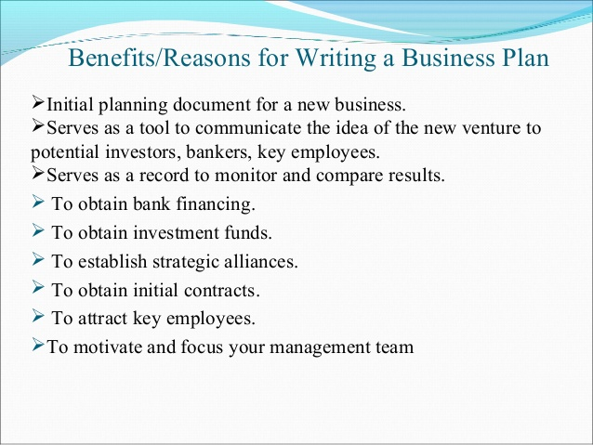
Which one you think is the reason of writing a business plan part of project

Slide 4
Outline of the Business Plan (cover all these aspects of your project) First “Cover Page” then “Table of Contents”
Executive Summary (if executive summary is convincing only then ask for full business plan)
Short overview of the entire business plan
Company Description
Company history
Mission statement
Products and services
Current status
Legal status and ownership
Key partnerships (if any)
Industry Analysis
Industry size, growth rate, and sales projections
Industry structure
Nature of participants
Key success factors
Industry trends
Long term prospects
Market Analysis
Market segmentation and target market selection
Buyer behavior
Competitor analysis
Marketing Plan
Overall marketing strategy
Product, price, promotions, and distribution
Management Team and Company Structure
Management team
Board of Directors
Board of Advisers
Company Structure
Operations Plan
General approach to operations
Business location
Facilities and equipment
Product (or Service) Design and Development Plan
Development status and tasks
Challenges and risks
Intellectual property
Financial Projections
Sources and uses of funds statements
Assumptions sheet
Pro Forma Income statements
Pro Forma Balance Sheets
Pro Forma Cash Flows
Ratio Analysis

Slide 5
The 10 most important questions a business plan should answer (part of project)
Is the business just an idea / opportunity with real potential.
Is the product / service viable (add significant value to customer) (feasibility analysis completed ? ) (Results ? )
Business entering into exciting / growing industry (has the firm found any attractive position)
Business has well defined target market ?
Does the business has points of differentiation ?
Does the business has sound marketing plan ?
Is the management team experience / skilled to launch a new firm ?
Is the business’s operations’ plan appropriate and sound ?
Assumptions (financial on realistic grounds ) ?
Financial projections completed correctly (is bright future of the firm ) ?

Slide 6
All the slides from slide no. 5 will help to better understand different aspects of business plan (mentioned in slide no.4)
Yes you can include few / many concepts from these slides (from slides no. 5 onwards ) to give more professional look to your business plan……BUT minimum requirement of this project is to cover all topics that are mentioned on slide no.4

Slide 7
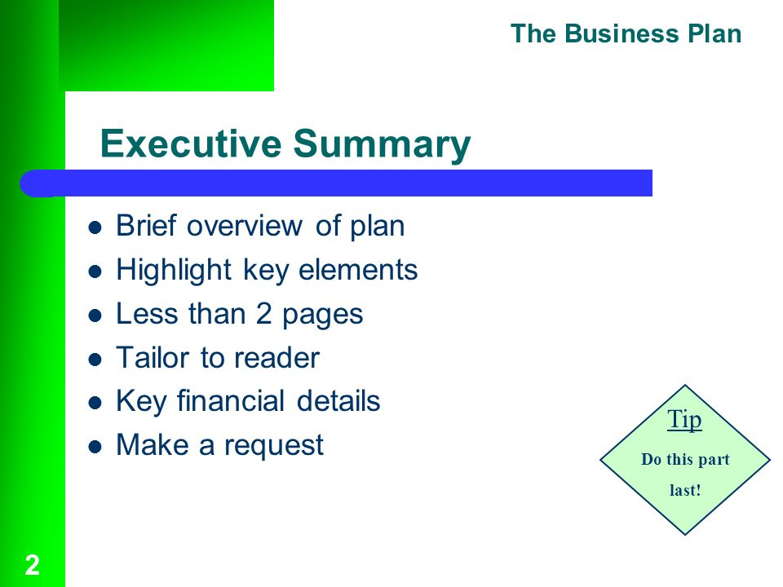

Slide 8
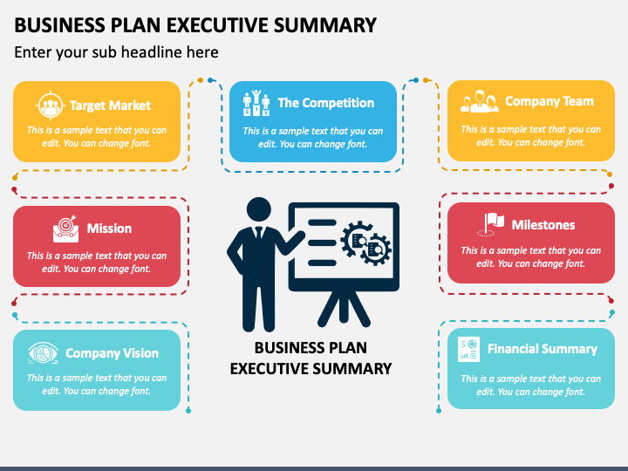

Slide 9
What to write in company Description Section ?
Company history
From where the idea for the company came.
Driving force behind its inception.
If it is a startup then must mention.
Mission statement
Why a company exists
What it aspires (dream) to become
Defines the path (financial / moral)
Products and services
How your products / services are unique
How to position (relative to its competitors) this in the market
Current status (explain through milestones)
Development stage (where your company is at this time ….)
Important milestones
Registered your company’s name
Completed a feasibility analysis
Written a business plan
Established a legal entity
Legal status and ownership
Current form of business ownership (partnership / private limited)
Key partnerships (if any)
Partnership with other companies to make your company work in competitive world.

Slide 10
Industry Analysis (before a business selects its target market, it should have a good grasp in its industry)
Industry size, growth rate, and sales projections
Promising areas of this industry
Points of vulnerability
Industry structure
How concentrated / fragmented
Fragmented industries are more receptive to new entrants than industries that are dominated by a handful of a large firms.
Nature of participants (companies)
Are the industry participants innovative or conservative
Key success factors
6-10 key factors (must be competent to compete)
Then differentiation.
Industry trends
Economic trends / social trends / technological trends / political & regulatory changes
Long term prospects
What are the trends
What you belief (as an entrepreneur)

Slide 11
Market Analysis
Market segmentation and target market selection
Dividing the market into distinct segments
Geographic (city / country)
Demographic (age / gender / income)
Psychographic (personality / lifestyle / values)
Buyer behavior
Competitor analysis

Slide 12
Marketing Plan
Overall marketing strategy
How it differentiates
Guidance for how the company should reach it s target markets via (4PCs)
Product, price, promotions, and distribution (sync with differentiation)

Slide 13
Management Team and Company Structure (investors first executive summary and then go directly to this section)
Management team
Brief profile of each member
Position (title)
Duties / responsibilities
Previous industry / related experience
Previous successes
Educational background
Board of Directors (Legal responsibilities)
Board of Advisers (No legal responsibilities)
Company Structure
Organizational chart (graphical representation of authority / responsibility)

Slide 14
Operations Plan (3-4 pages) (how the business will be run) (what could be break / make issues)
General approach to operations
Business location
Facilities and equipment

Slide 15
Operations Plan (3-4 pages) (how the business will be run) (what could be break / make issues)
Back Stage (Behind the Scenes Activities )
Front Stage (What the Members See)
Staff selection
Operations manual
Relationship with suppliers
Relationships with govt.
Development of marketing materials
Employee orientation and training
Emergency plans
Member tours
Operating hours
Staff assistance
Fitness classes and programs
Fitness machines
Workshops
Monthly newsletter

Slide 16
Product (or Service) Design and Development Plan
Development status and tasks
If developing new products / services then must mention
What are your development efforts
Details of logical path of that new product development
timelines
Challenges and risks
Intellectual property

Slide 17
Financial Projections
Sources and uses of funds statements
How much money a firm needs
Where the money will come from
What the money will be used for
Assumptions sheet
Pakistan population is going to be increased by 3% annually
Sales projections are based on this population growth
Pro Forma Income statements (future not past – 3 to 5 years)
Pro Forma Balance Sheets (future not past – 3 to five years)
Pro Forma Cash Flows (future not past – 3 to five years)
Ratio Analysis
Return on assets
Return on sales

Slide 18
Common business planning mistakes while making a business plan
Overall mistakes
Entrepreneurs are unable to clearly articulate their vision in the plan.
They are failed to provide sufficient details regarding the implementations of their strategy.
They ineffectively present the goals and objectives which are most important to the business and success.
They do not convincingly present the basis for their strategy.
They do not improve their plan based on the feedback from investors.
Executive summary.
They do not precise about their needs and capabilities.
They waste words with fillers and superfluous information.
Management.
They forget to include their previous successes and or failures.
They dismiss the importance investors place on an experienced management team.
Marketing.
They rely heavily on secondary market research rather than soliciting the opinions of their potential customers.
They claim the percent of the market their company will own without research support.
Financials.
They overlook and in turn underestimate their cash flow requirement.
They inflate or underestimate their margins in order to arrive at their ideal profitability.

Slide 19
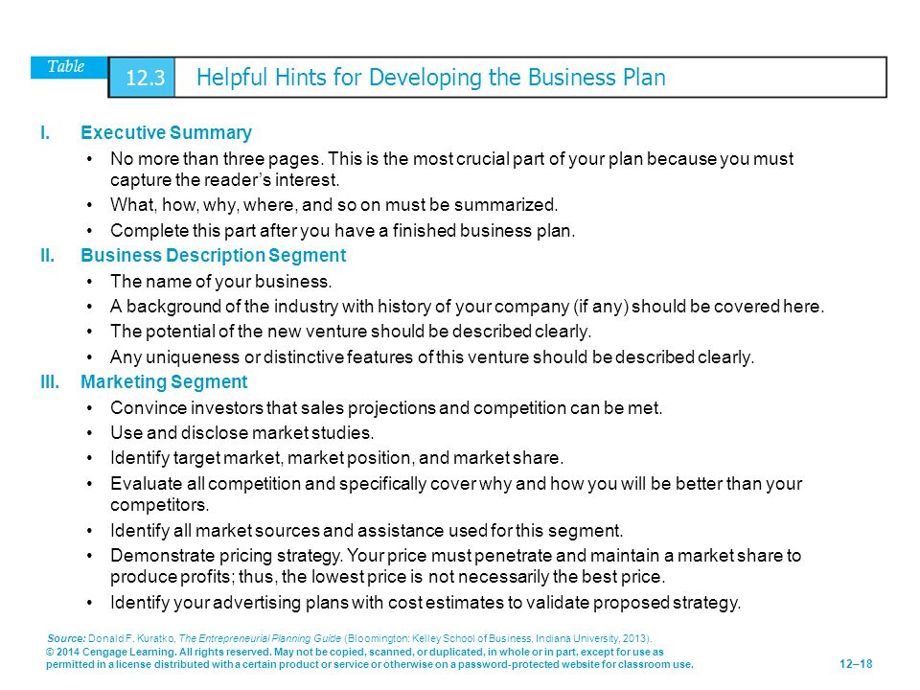

Slide 20
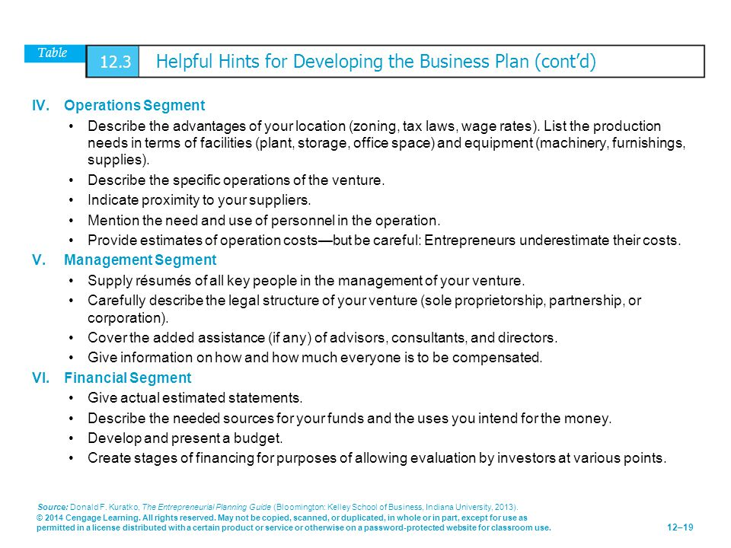

Slide 21
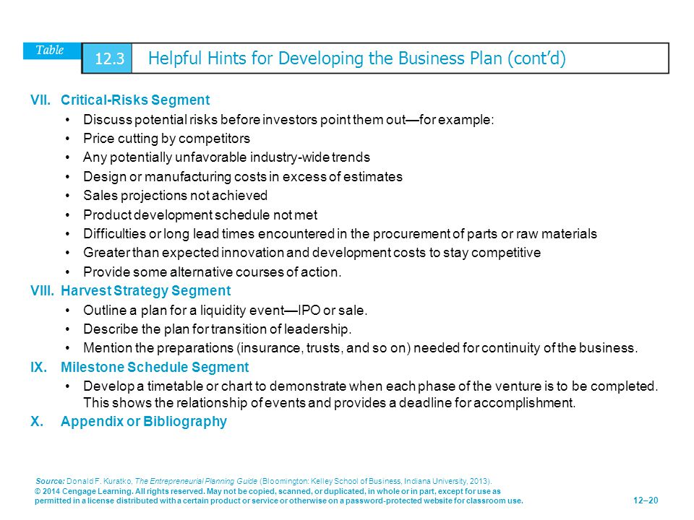

Slide 22
Types of Business Plan (different rule of thumb regarding the length and level of detail)
Summary Business Plan
10 to 15 pages
New ventures in the early stages of development
Want to test the waters
To see if the investors are interested in their idea
Full Business Plan (focus of this chapter)
25 to 35 pages
Spells out the company’s operations and plans in much more detail than summary business plan
Works best for new ventures that are at the point where they need funding (serves as blueprint for the company operation)
Operational Business Plan
40 to 100 pages
Meant for the internal audience
Works best as a tool for creating a blueprint (providing guidance to ta operational managers)

Slide 23


